Slide 1
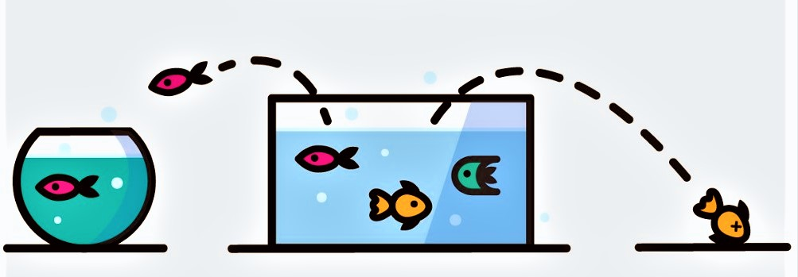
Telco Customer Churn
Data Analytics | 3rd Party Data|Telecommunications Sector
Notes:
https://www.displayr.com/predict-customer-churn-gradient-boosting/

Slide 2
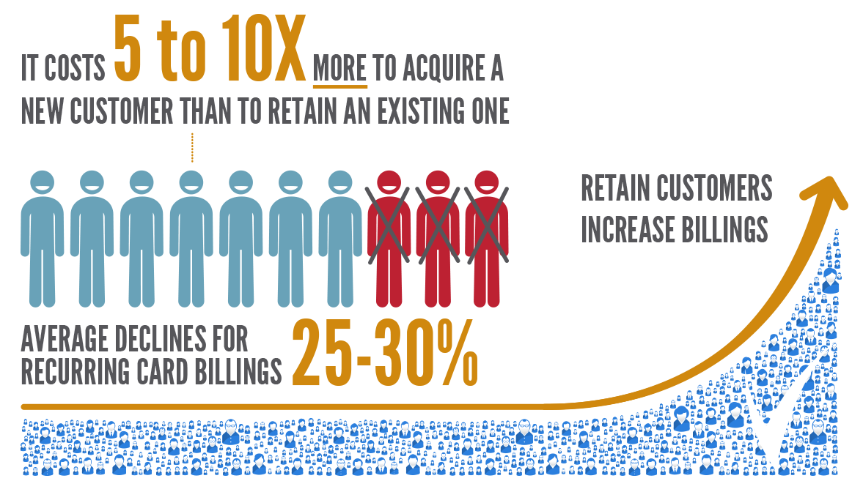
Notes:
https://www.verifi.com/decline-salvage/

Slide 3

Notes:
https://quotefancy.com/quote/20016/Bill-Gates-Your-most-unhappy-customers-are-your-greatest-source-of-learning

Slide 4
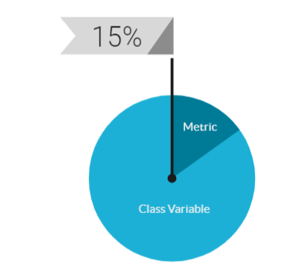
Dataset Overview
Gender
Senior Citizen
Partner
Dependents
Tenure
Multiple Lines
Phone Service
Internet Service
Online Security
Online Backup
Device Protection
Tech Support
Streaming TV
Streaming Movies
Contract
Paperless Billing
Payment Method
Internet Service
Total Charges
Monthly Charges
Notes:
Analyze the Dataset

Slide 5
Assumptions
Data set is not merged with other datasets for improved insights.
Tenure has zero values. It is assumed that they have not completed a month yet.
Senior Citizen is a Boolean flag. It takes the values of either 0 or 1.
Total charges are 0 despite there are monthly charges. At a closer look, we can see that the tenure for these entries are 0. The bill has not been generated, and the total value column is yet to be filled.
Notes:
Assumptions

Slide 6
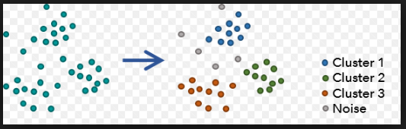
CLUSTERING
Descriptive analysis
Pattern recognition
Spatial data analysis
Intra-cluster distance minimized
Inter-cluster distance maximized
Notes:
Introduce Decision Tree
Mention why decision tree is used in the first place

Slide 7

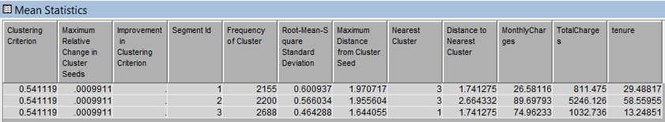
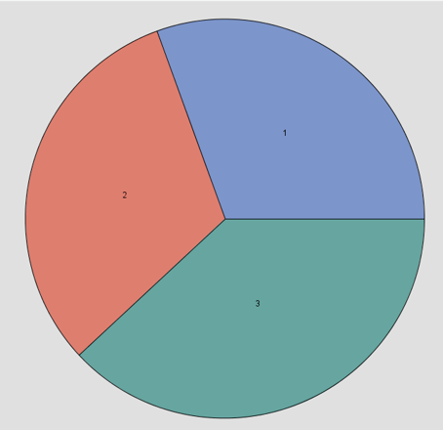
Clustering
Columns considered are: Tenure, Monthly Charges, Total Charges
Three clusters are obtained in the result:
Tenure: 30 months, Total charges: $800, Monthly charges: $25
Tenure: 60 months, Total charges: $5000, Monthly charges: $90
Tenure: 12 months, Total charges: $1000, Monthly charges: $75

Slide 8
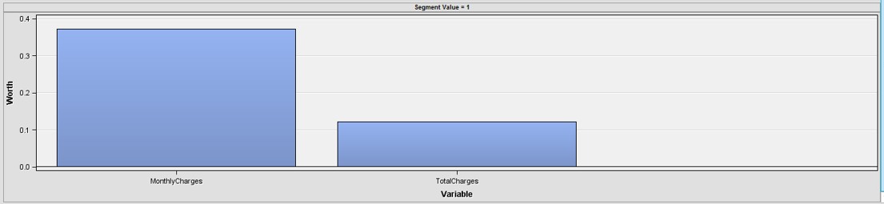
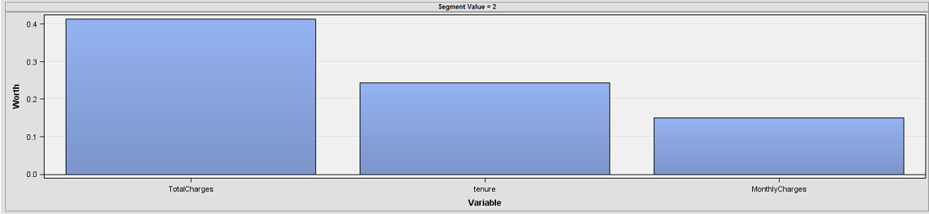
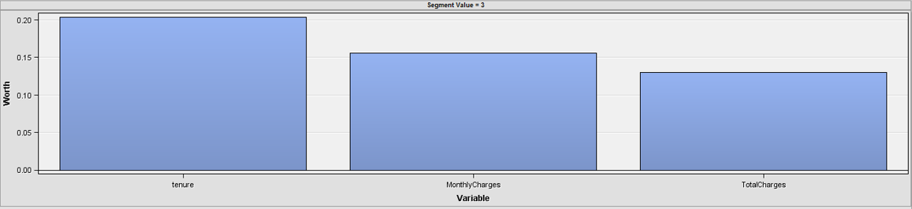
Segment Profiling
Segment #1 :
Most Influential: MonthlyCharges
No Influence: tenure
Segment #2 :
Most Influential: TotalCharges
Segment #3 :
Most Influential: tenure

Slide 9
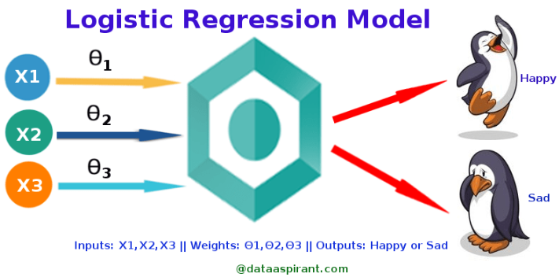
LOGISTIC REGRESSION
Regressions offer a different approach to prediction compared to decision trees.
Regressions, as parametric models, assume a specific association structure between inputs and target.
Notes:
Introduce Decision Tree
Mention why decision tree is used in the first place

Slide 10
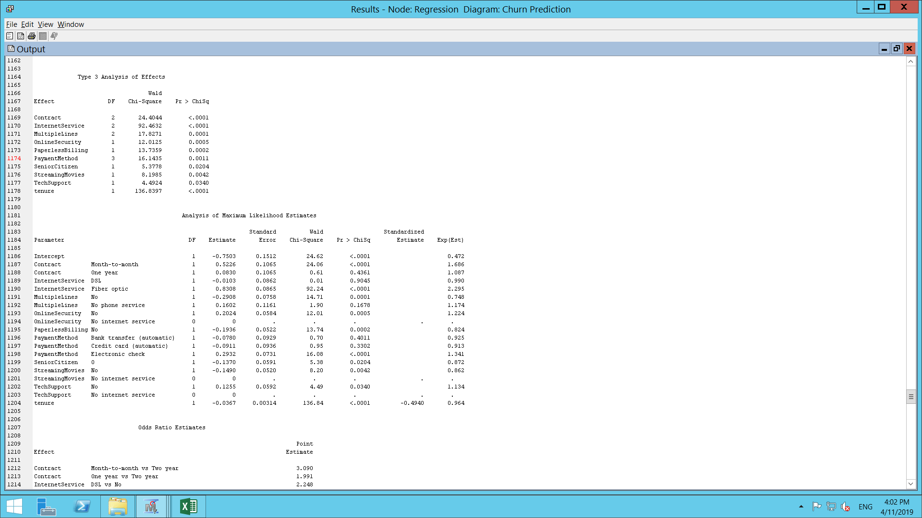
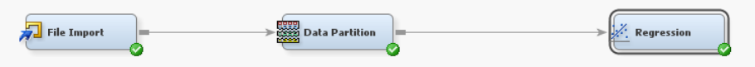
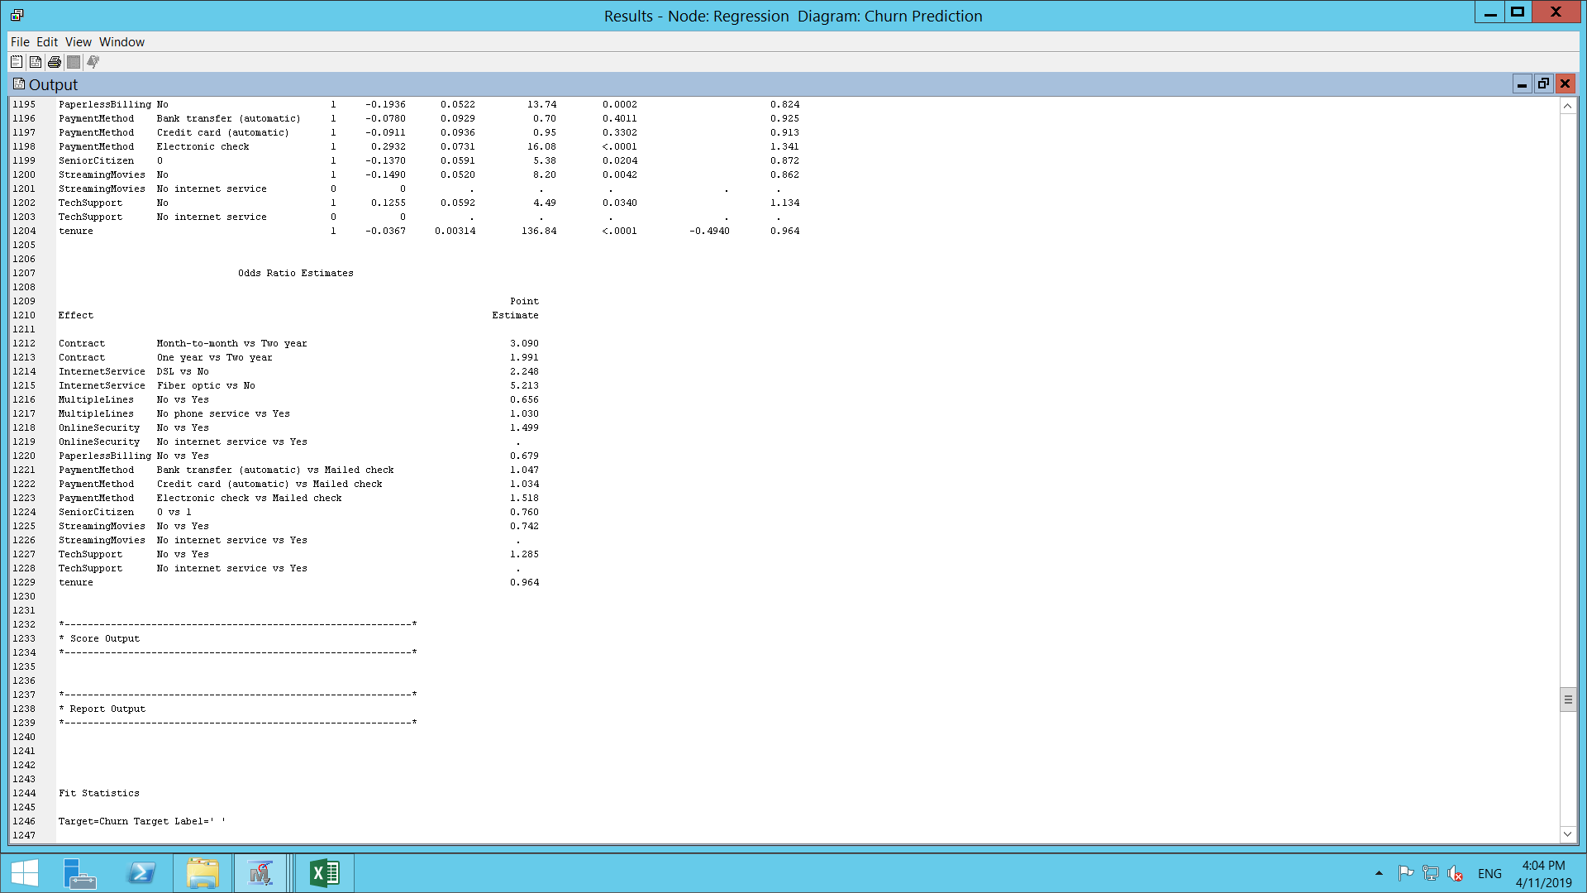
Logistic Regression

Slide 11
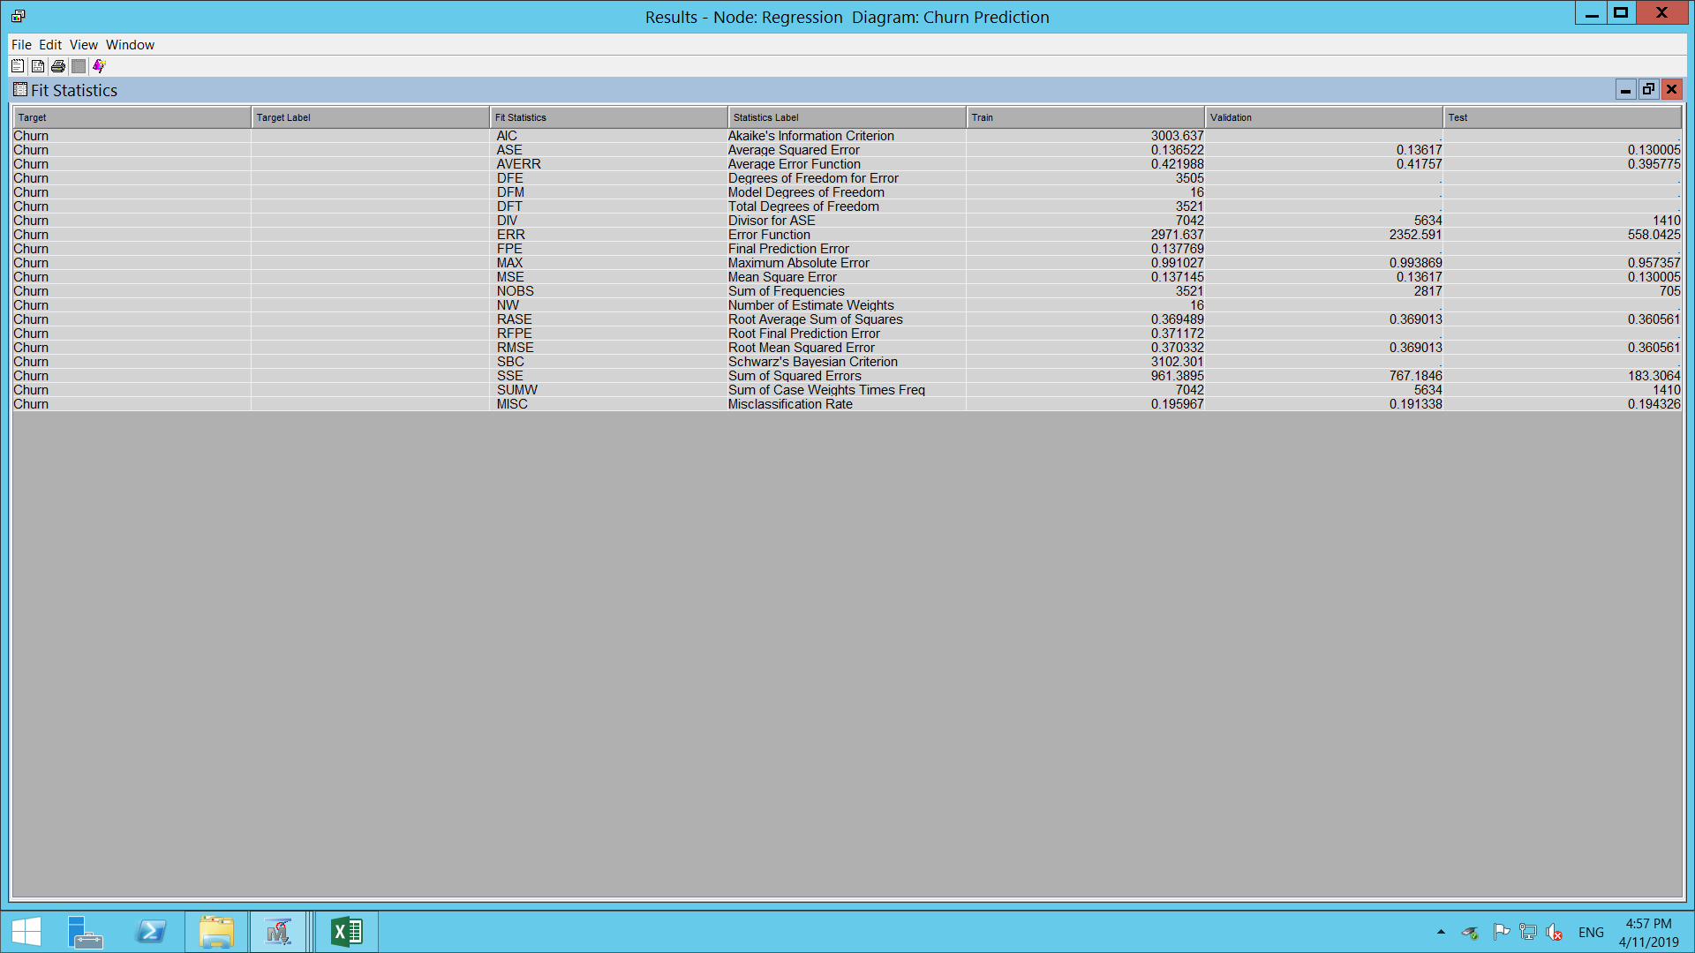
Fit Statistics
Average Square Error – 0.13
Root Mean Square Error – 0.37
Misclassification Rate – 0.19
Notes:
Talk about the 3 metrics – Fit Statistics

Slide 12
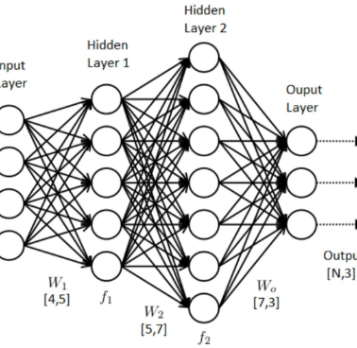
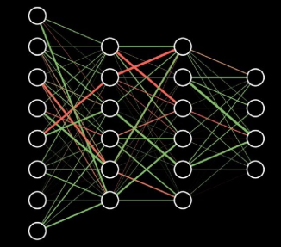
NEURAL NETWORKS
Nonlinear relationships and interactions taken care of inherently
Does not require prior knowledge of relationships between inputs and outputs
Prediction accuracy is comparable with other statistical methods
Notes:
Introduce Decision Tree
Mention why decision tree is used in the first place

Slide 13
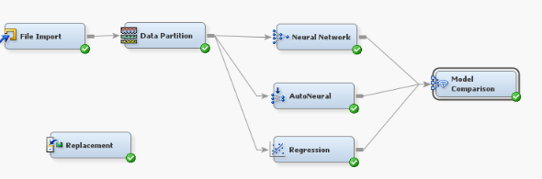
Workspace Diagram

Slide 14
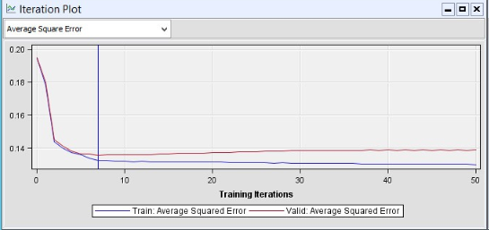
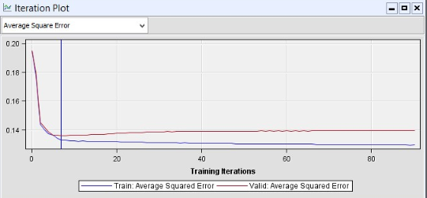
Model Assessment
Max Iterations – 50, Divergence – 8
Max Iterations – 100, Divergence – 7

Slide 15
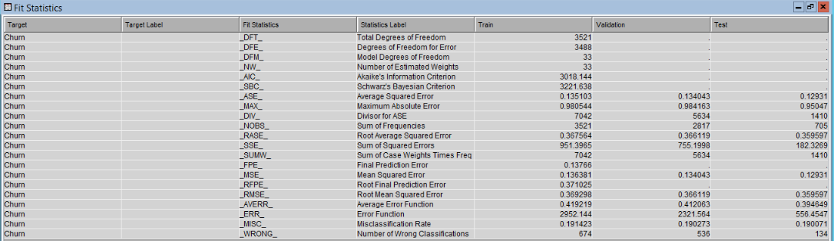
Fit Statistics
Average Square Error – 0.13
Root Mean Square Error – 0.36
Misclassification Rate – 0.19
Notes:
Talk about the 3 metrics – Fit Statistics

Slide 16
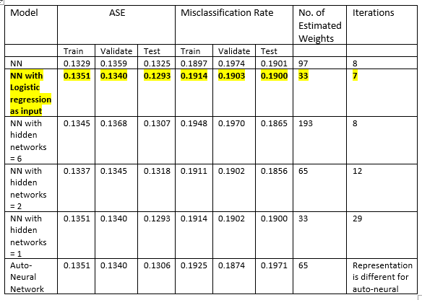
Final Findings

Slide 17
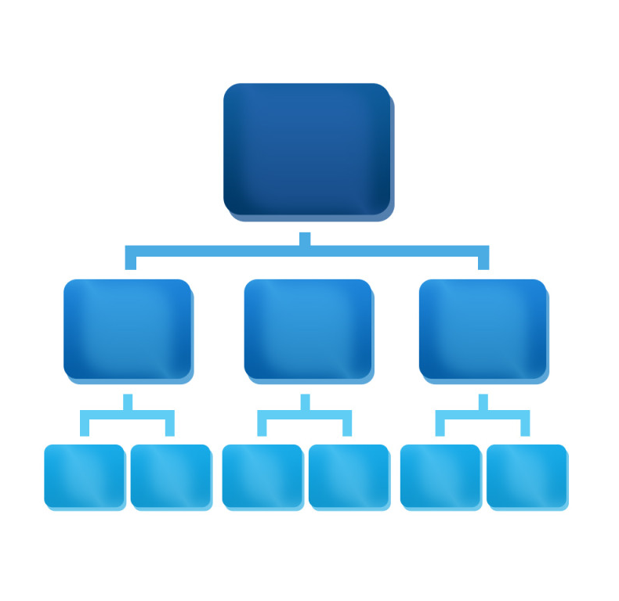

DECISION TREE
Suits Classification
Suits Categorial Data
Easily Comprehensible
Easy to Cultivate
Notes:
Introduce Decision Tree
Mention why decision tree is used in the first place

Slide 18
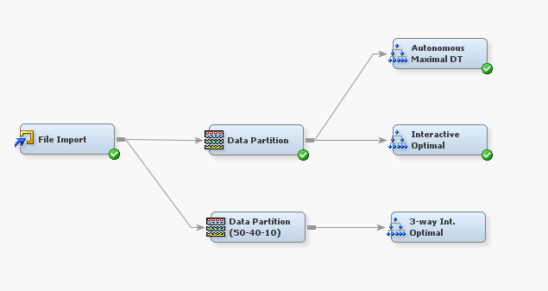
DECISION TREE CULTIVATION
Autonomous Maximal
Interactive Optimal (2 Way)
Interactive Optimal (3 Way)
Notes:
What all types of decision trees where used?
Why were the first 2 dropped?

Slide 19
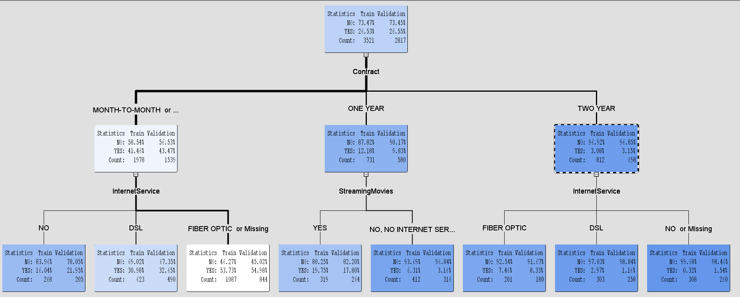
INTERACTIVE OPTIMAL 3-WAY DECISION TREE

Slide 20
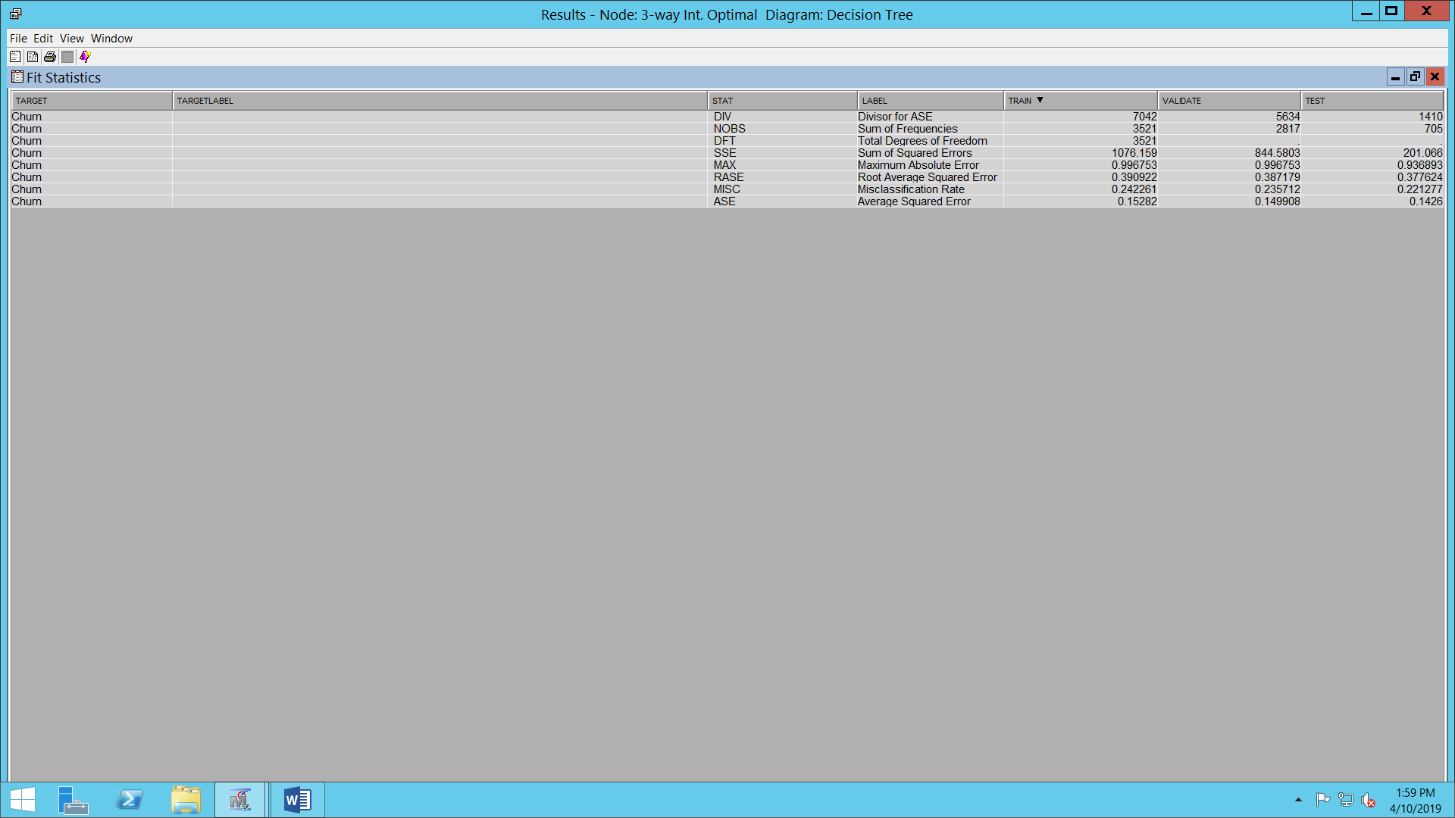
Fit Statistics
Average Square Error – 0.15
Root Mean Square Error – 0.4
Misclassification Rate – 0.24
Notes:
Talk about the 3 metrics – Fit Statistics

Slide 21







Insights
Customers with Older Tech
Churn
less
Longer the
Contract
Longer the people Stay
People who
stream less
Stay

Slide 22
Business Actions
Seal Long terms contracts with customers by selling gadgets and telco connections together.
Keep the customers with relatively new technology under close supervision; provide them customized offers. Try to sell branded products to this segment and slowly turn them into loyalists. Make them progress the ladder of loyalty.
Even though, the people with older technology stay longer, if they do not venture into the new products, the company cannot progress. The company must strike a balance here and slowly transition them into newer technology.
Customers who are onboarding the new technologies should be awarded with lucrative offers that will make them stay. The clustering analysis done will provide more insights into choice of segment.
Notes:
Business Actions

Slide 23
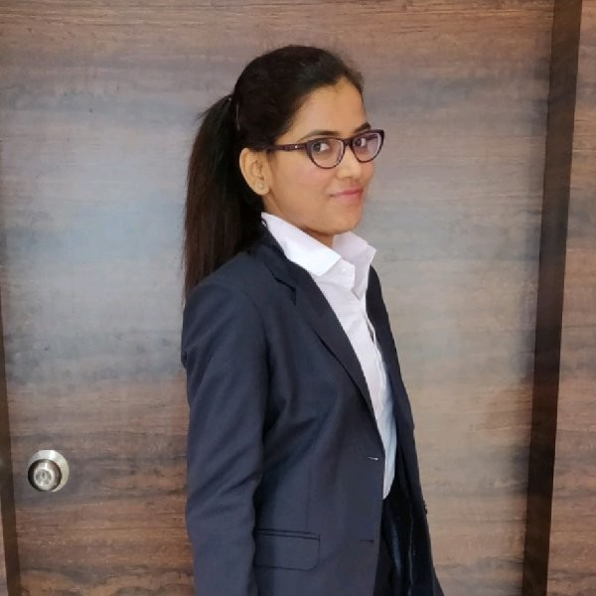

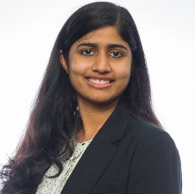
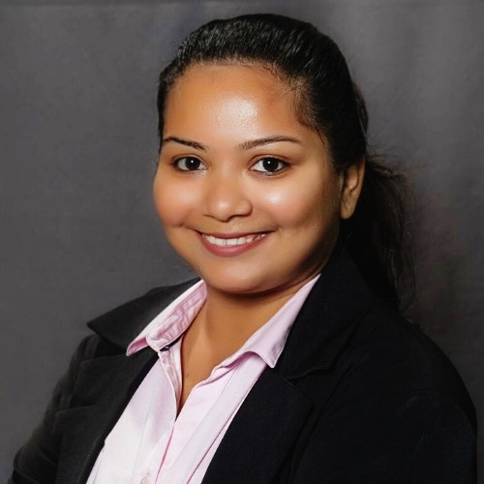
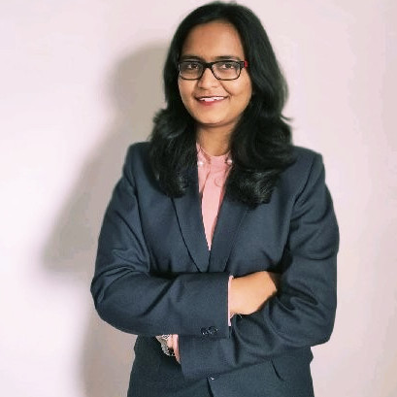

SRISHTY KSHIRSAGAR
NEETHU NARAYANAN
NAMRATA PATIL
JAGRUTI WAGH
ANAND MURALEEDHARAN

